Slide 1
Executive Summary Problem Statement - The dataset which comprises of tele-calling operation. - A team of three members, who called to the lead, who had applied the jobs via job assistant. - Based on the individual interests, move them for an interview and get it on board process. - Follow up with the lead who don’t answer or in RNR status. Objective - Effective and Efficient are tele-calling operations. - Recommendation of effective and efficiency of the tele-calling. - Future scope to add the business value.

Slide 2
Approach - Analysis of the data sets, such as lead, lead call, Tele caller. - Lead which consist of sources, state, isExternal and primary key for the lead calls. - Lead calls consist of foreign key and other essential data closed to 12k - Merging of the records from three different data, and making the consolidation version of the whole dataset. - Filtering the records, as some data was futuristic. - Maintaining the essential column from the consolidation version, and sub setting it further as an when it’s required. This is for deep diving specifically on the fields and keeping the performance. - Sub setting helps to find out the exact column to be analyzed in optimized manner. - Maintaining the appropriate grouping from the sub setting of the consolidation version.

Slide 3
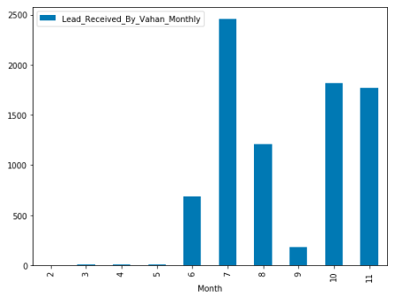
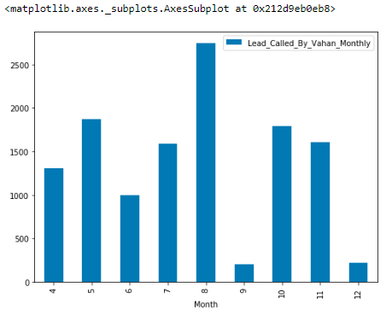
Exploratory Data Analysis From this I wanted to see, by when the Lead was received by Vahan and when the Tele-calling operation takes place for the adding the business value. Also the Monthly representation shows, the spike are very often, which depends on the Lead arrival in Vahan

Slide 4
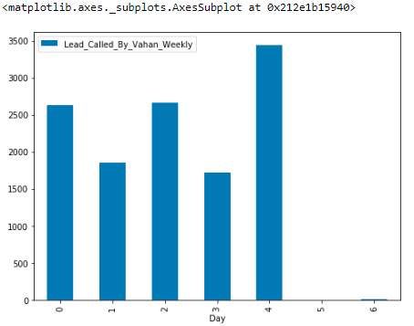
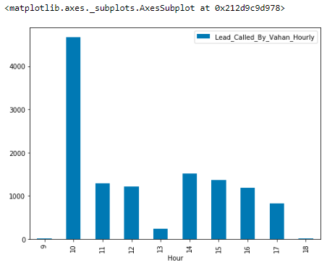
Exploratory Data Analysis From this I wanted to see, on which day tele-calling takes place, and also the business timing, which is adding the core value and measuring the effective goal of the organization.

Slide 5
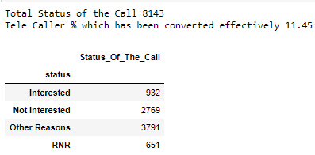
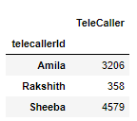
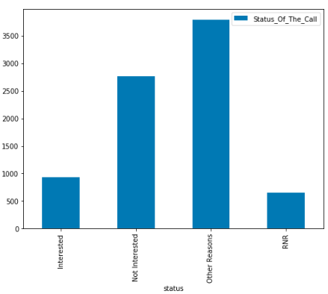
Exploratory Data Analysis From this I wanted to see, how many of them has been converted, which is around 12% of the total calls made by Vahan, and how many of the calls taken care by the individual Tele Caller, deep diving further.

Slide 6
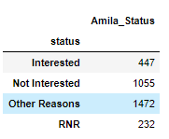
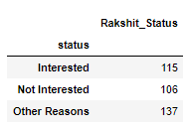
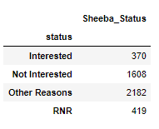
Amila had 13 % conversion of the total calling data. Rakshit had 32 % conversion of the total calling data. Sheeba had 8 % conversion of the total calling data.
In total from the Interested category of all Tele Caller – 932
Sheeba contribution - 39.7 Rakshi contribution - 12.34 Amila contribution - 47.96

Slide 7
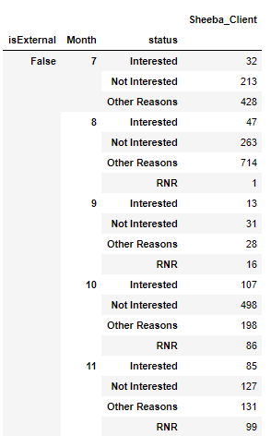
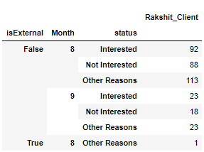
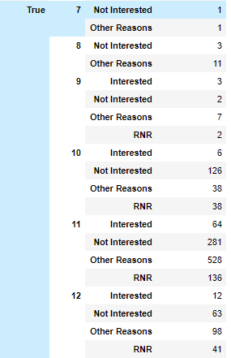
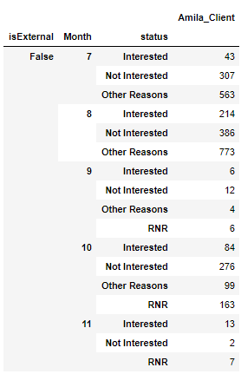
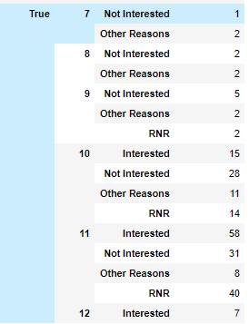
# Amila had bought the most conversion from the job assistant rather than the third party
80 conversion out of 447 was done from the third party sources, around 17 % conversion
on other end from the job assistant 83% conversion rate.
# Rakshit had bought the most conversion from the job assistant rather than the third party
100% conversion from the job assistant only.
# Sheeba had bought the most conversion from the job assistant rather than the thrid party
83 conversion out of 370 was done from the third party sources, around 21 % conversion
on other end from the job assistant 79% conversion rate

Slide 8
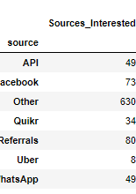
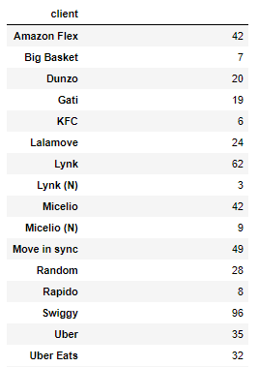
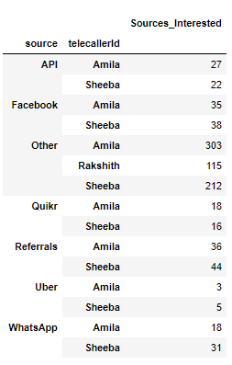
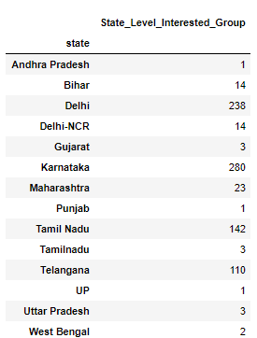
In this we can see the collectively areas and key element from where we had the successful conversion available by Vahan Tele-calling and it’s operator, this mechanism show of the effectiveness and efficiency, though there can be some improvisation for the same.

Slide 9
Insights - Status of call was less converted, further analysis required. - Tele caller was less in order to handle such huge crowd. - Sources was not involved much in order to conversion. - isExternal with status was not involved much in conversion. - These insights shows that the distribution was appropriate Recommendation - More Tele operator required, so the efficiency will increase and conversion rate. - Appropriate platform required, so that sources can be approached to the most of the job aspirant. - State level analysis required, as only few states was part of the conversion. May be setting up offices and reaching out the job profile matches. - Client level, need to be focused more, and it should be monitored closely because only bringing from one client will be monopoly.

Slide 10

Future Scope - Clustering and Classification can be implement to identify the sources and client for the tele operator. - Time duration can be focused more and recording, so that we can understand the reason why conversion are being missed. - Forecasting and waiting time can be the essential parameter for predicting.

